Slide 1

Project Alexandria
The future of reading
By: Alwyn, Erin, Jimmy

Slide 2

Problem Statement and Motivation
Reading Indecision: large selections overwhelm users, leading to less overall reading.
Lack of Motivation: difficulty and complexity in finding a book that matches user interest discourages them from reading.
Limited Personalisation: normal bookshelves aren’t interactive and can't help you decide.
Accessibility: disabilities and age may make itt hard to locate or pick a book
Digital to physical disconnect digital recommendation systems do not always account for physical availability

Slide 3
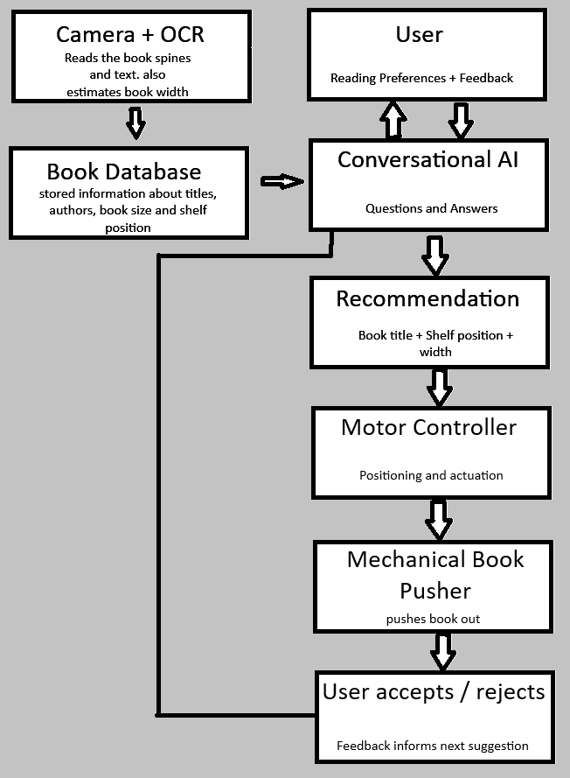
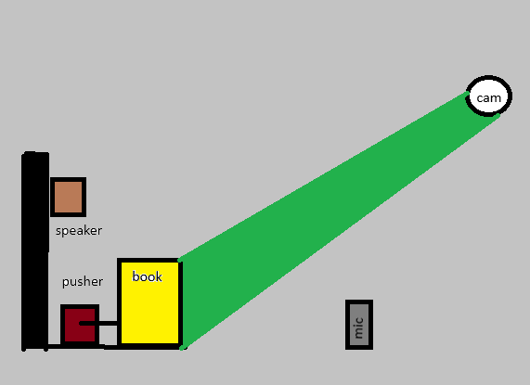

Proposed Solution

Slide 4

System Architecture
Book Recognition: a camera captures book spines and OCR extracts their titles and estimated positions.
Database Generation: Identified books and their shelf position stored in a database.
Ai Recommendation: AI model interacts with user, asking questions and pushing recommendations
Robotic Actuation: pushes book recommendation out
User Feedback and Reset: resets to starting position and user manually pushes rejected books back In

Slide 5
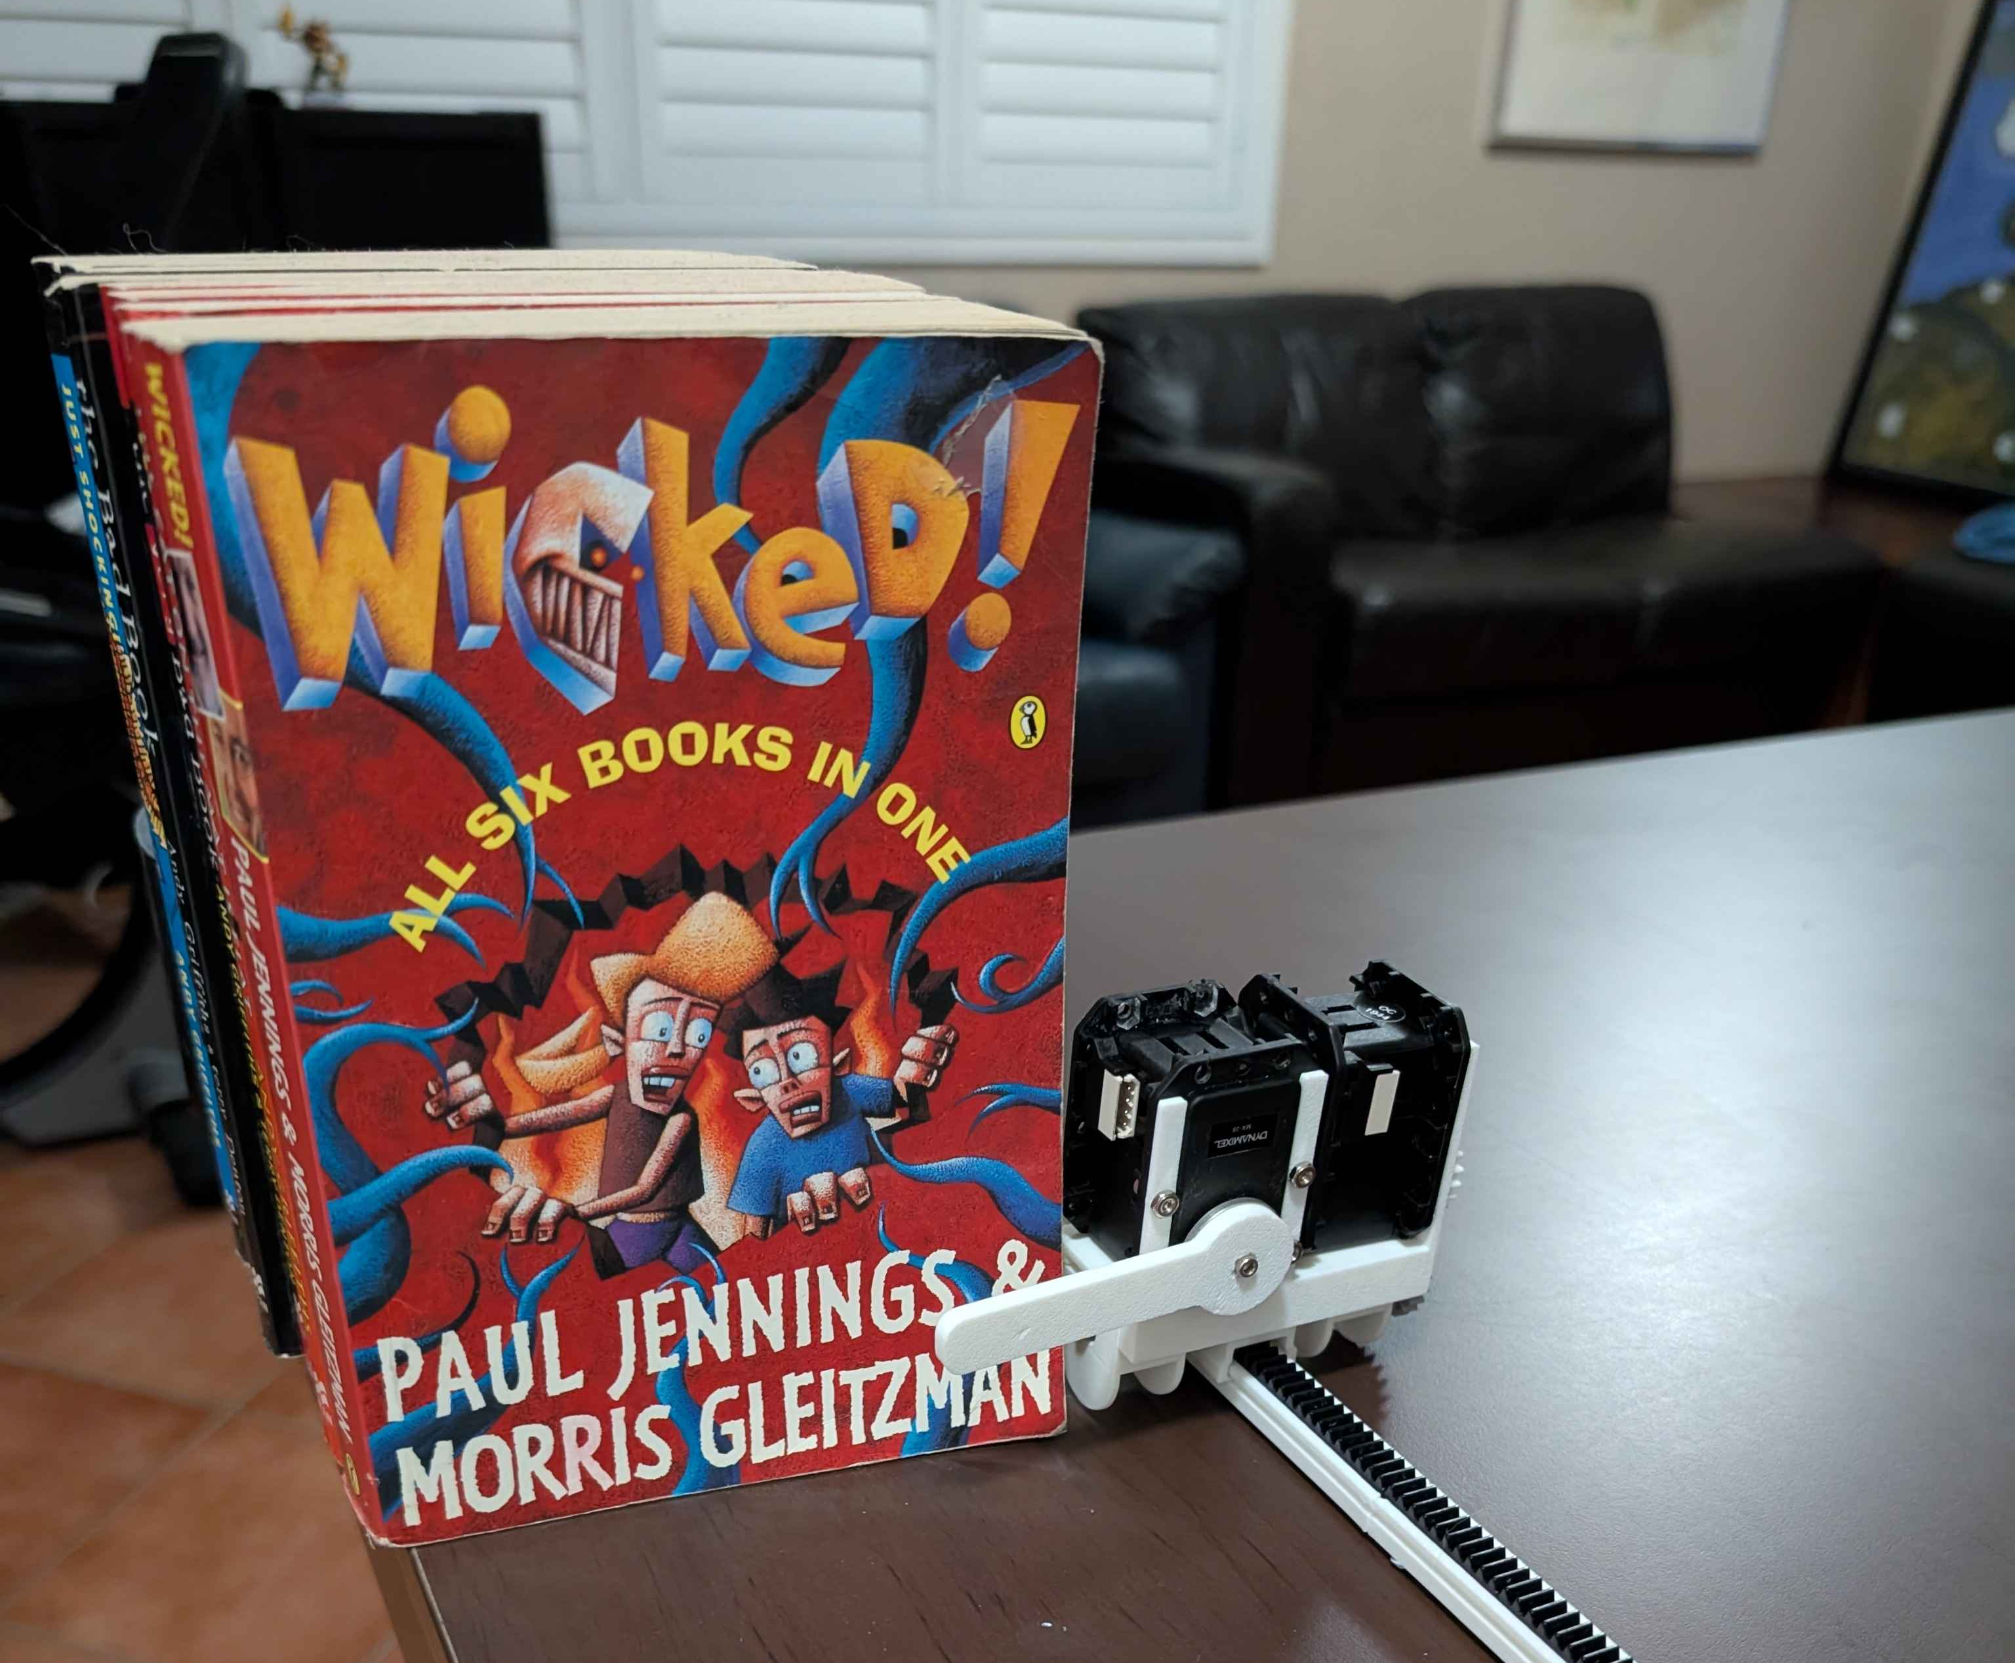
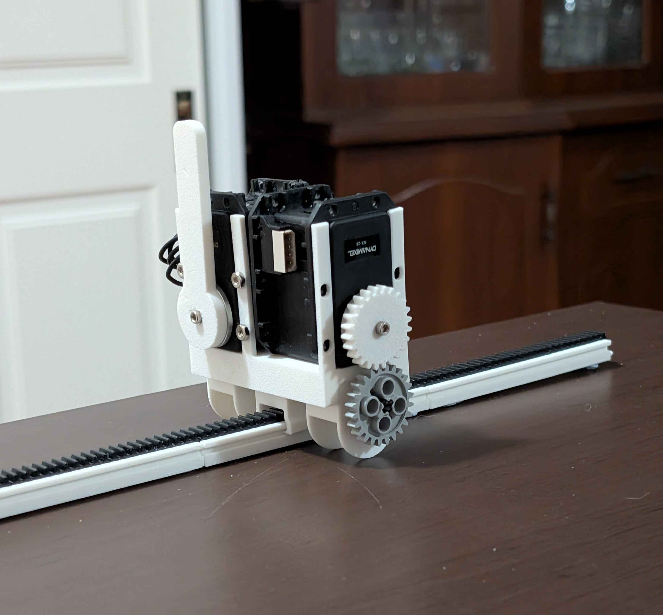
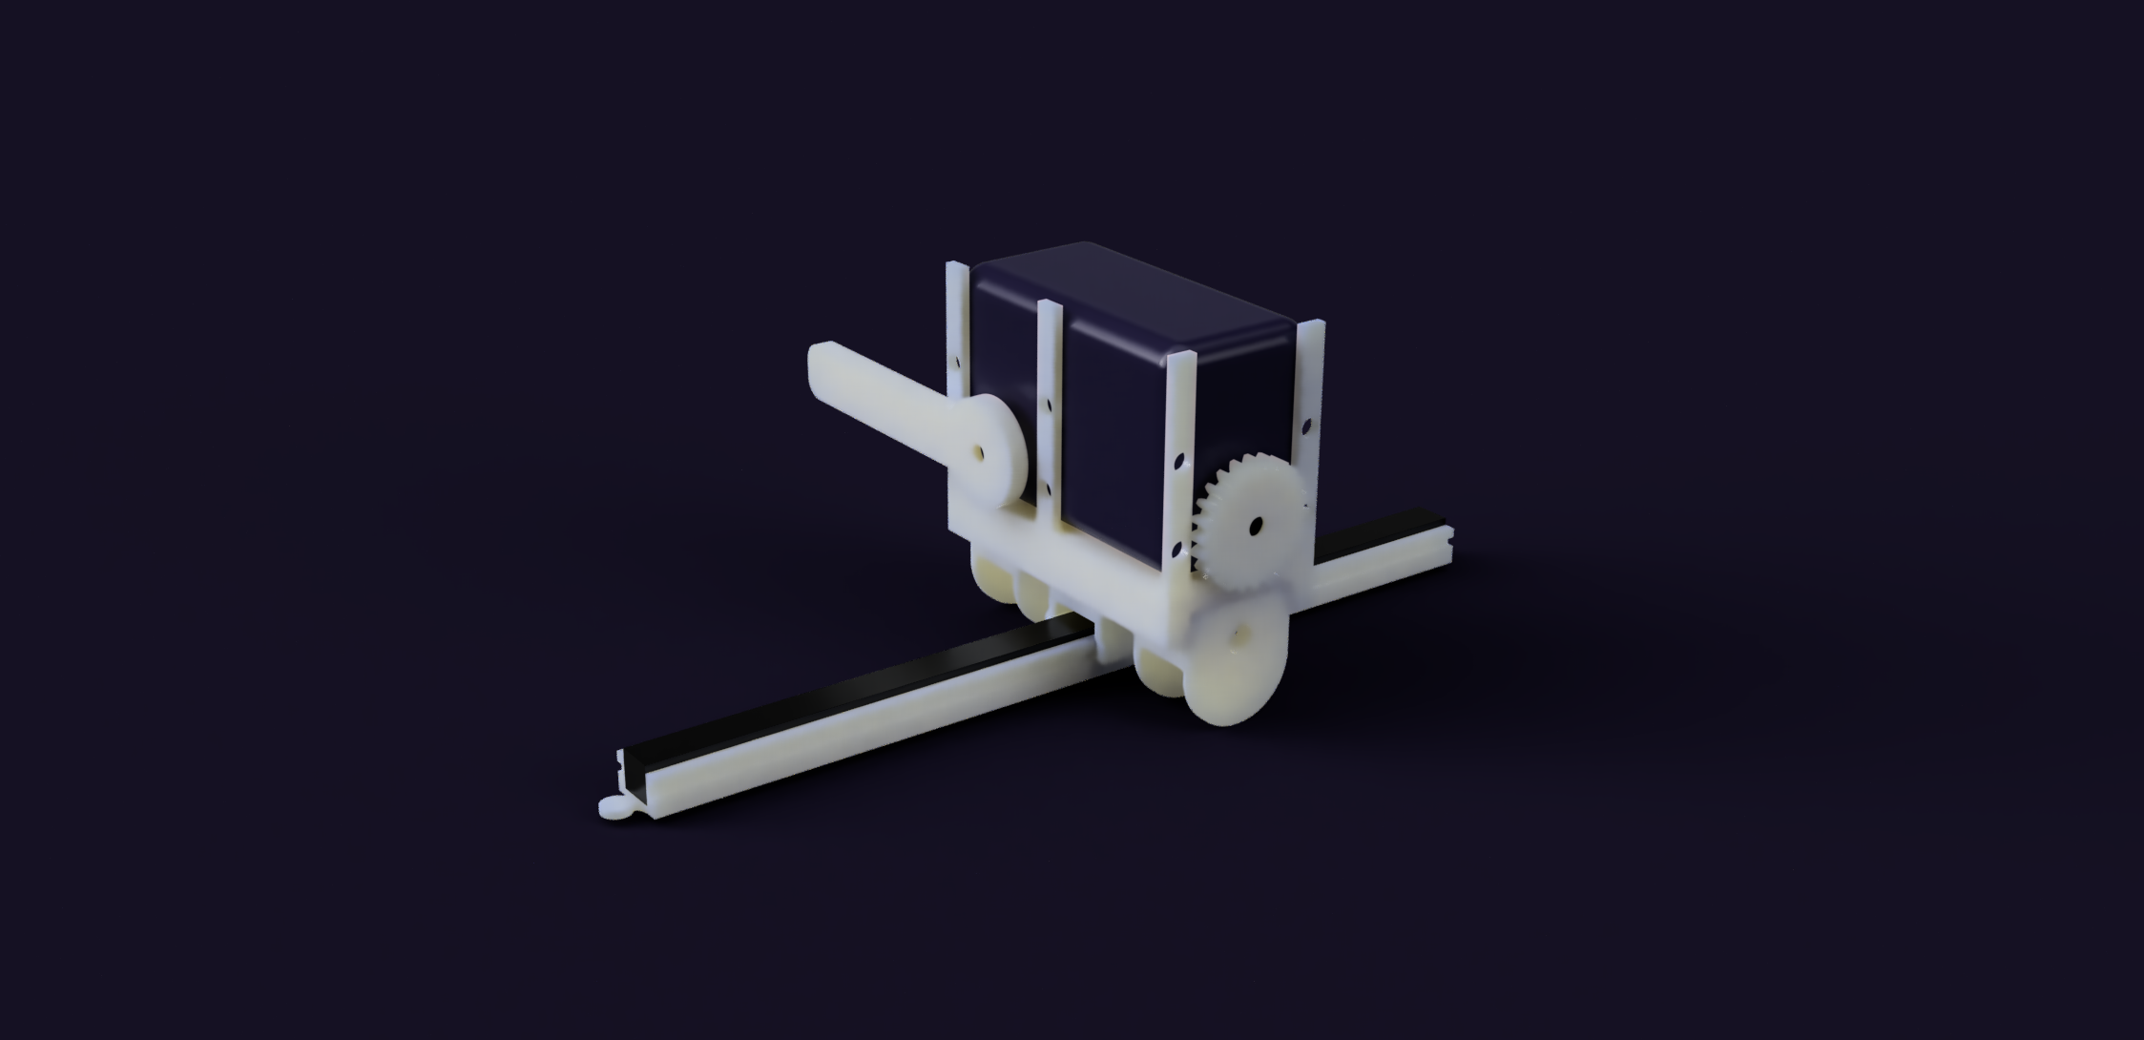
Prototype Demo and Development

Slide 6
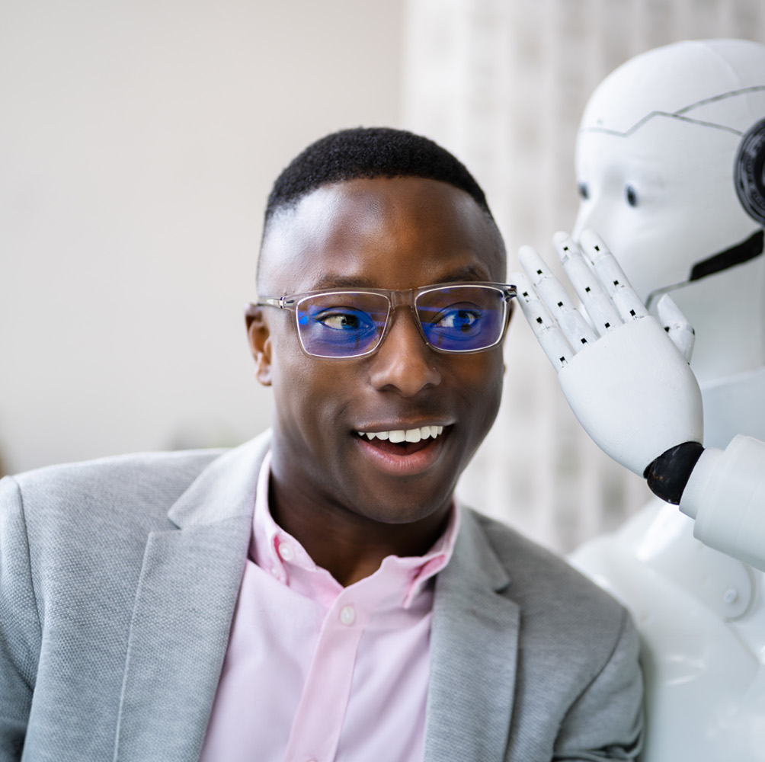
Human Robot Interaction Demonstration

Slide 7

Future Development
Integrate Camera and Microphone
Integrate AI model
Finalise prototype design
Fault and Solution Testing
Integrate OCR and object detection for book identification

Slide 8
Summary
Introduces an Interactive Bookshelf Concept combining personalized recommendations with robotic actuation.
Uses Mechanical motor movements to identify and present a selected physical book
Demonstrate how Human-Robot Interaction can connect digital decision making with physical objects
Establishes a foundation for intelligent bookshelf automation

